Slide 1

Exploring Salary, Skills, and Specializations in AMCAT Data
Presented By:
Patwari Raghottam

Slide 2
Background: Bachelor of Technology (B.Tech) in Electronics and Communication Engineering.
Interest in Data Science: Passionate about learning new techniques in Machine Learning and applying analytical
Skills to solve complex problems.
Work Experience: Worked as an Associate Software Engineer at DXC Technology, specializing as an
SAP FICO Consultant.
LinkedIn URL: https://www.linkedin.com/in/raghottam-patwari/
Medium URL: https://medium.com/@patwariraghottam
GitHub URL : https://github.com/ragh945
our Medium URL here]
About me

Slide 3
Objective
The objective of the AMCAT Data Analysis test is to assess a candidate’s ability to interpret data, identify trends, and draw meaningful conclusions using analytical skills. It evaluates proficiency in handling datasets, statistical tools, and visualization techniques.

Slide 4
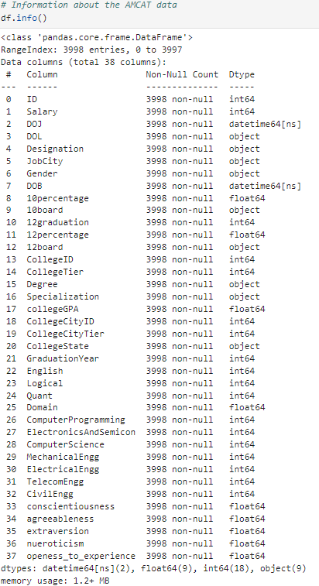
Summary of Data
Total Records: 3998 rows with 38 columns capturing candidate information.
Key Features: Salary, Designation, Gender, Job City, and Graduation Year.
Academic Data: Includes 10percentage, 12percentage, college GPA, and specialization details.
Technical Skills: Scores in Computer Programming, Electronics, Mechanical, and other engineering domains.
Personality Traits: Measures of conscientiousness, agreeableness, extraversion, neuroticism,and openness to experience

Slide 5
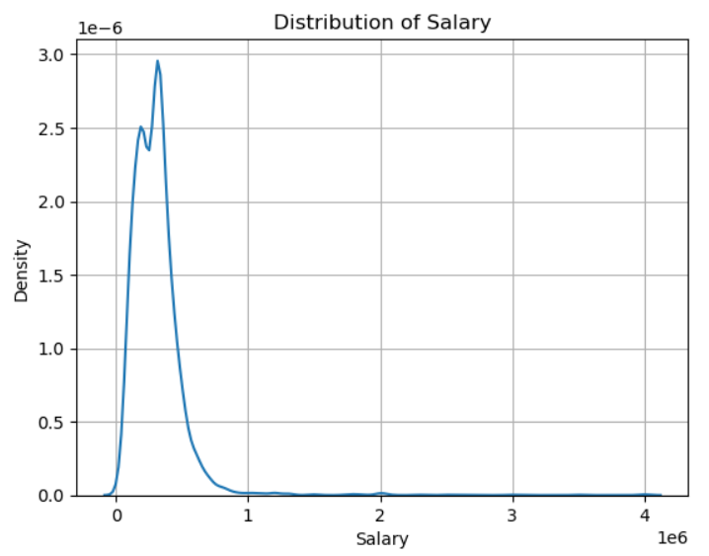
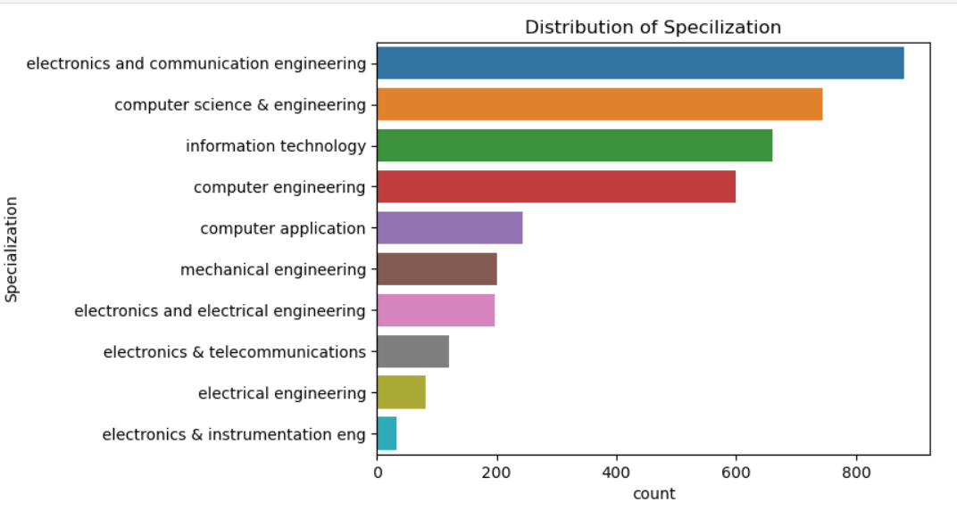
Univariate Analysis
Insights
In between 0 to 100000 the salaries are more compared to other salaries.
After 300000 there are less salaries
There are more electronics engineers compared to others.-
There are less electrical , instrumentation engineers..

Slide 6
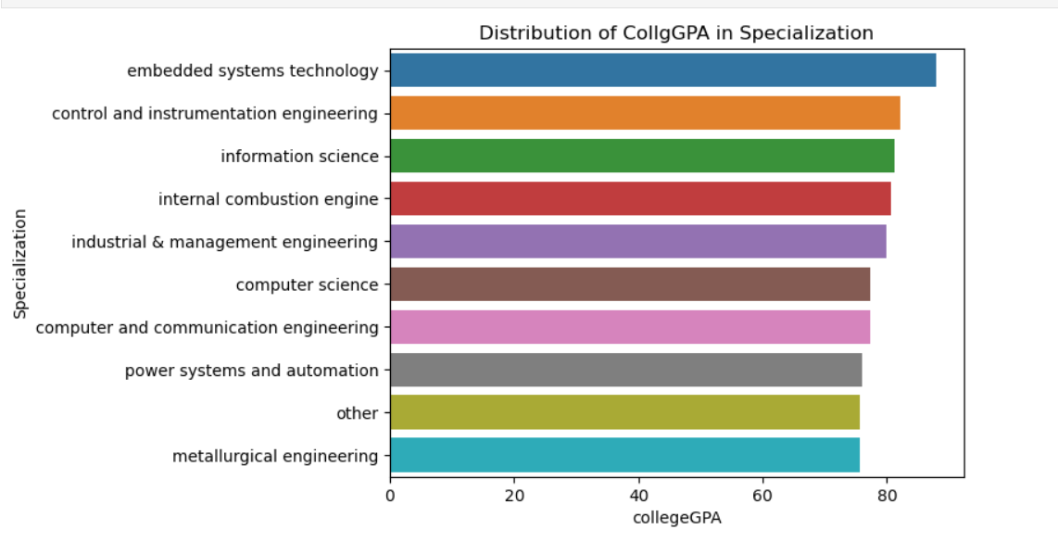
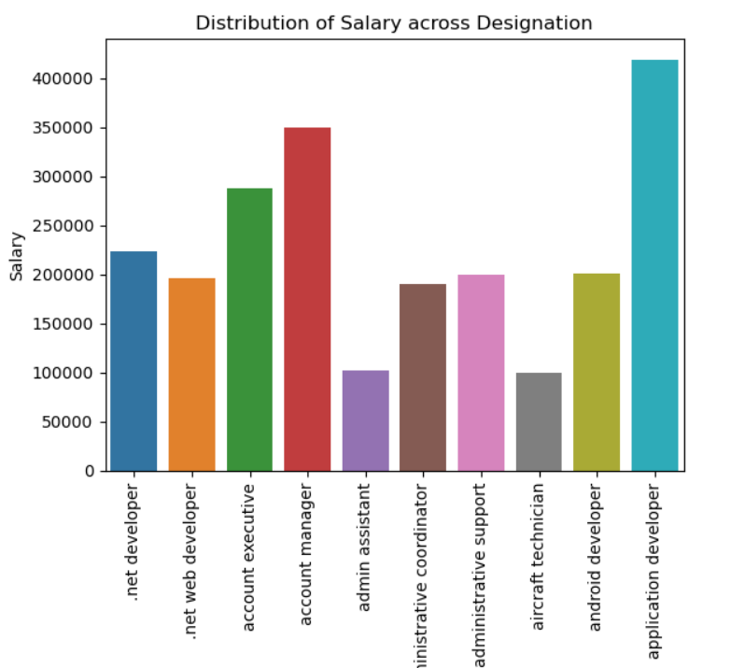
Bivariate Analysis
Insights
The Average GPA of embedded systems is more compared to others-
There are less GPA for others , metallurgical engineering compared to others..
Insights
The Average salary of application developer is more compared to other designations.
There are less salaries for admin assistant and aircraft technician.

Slide 7
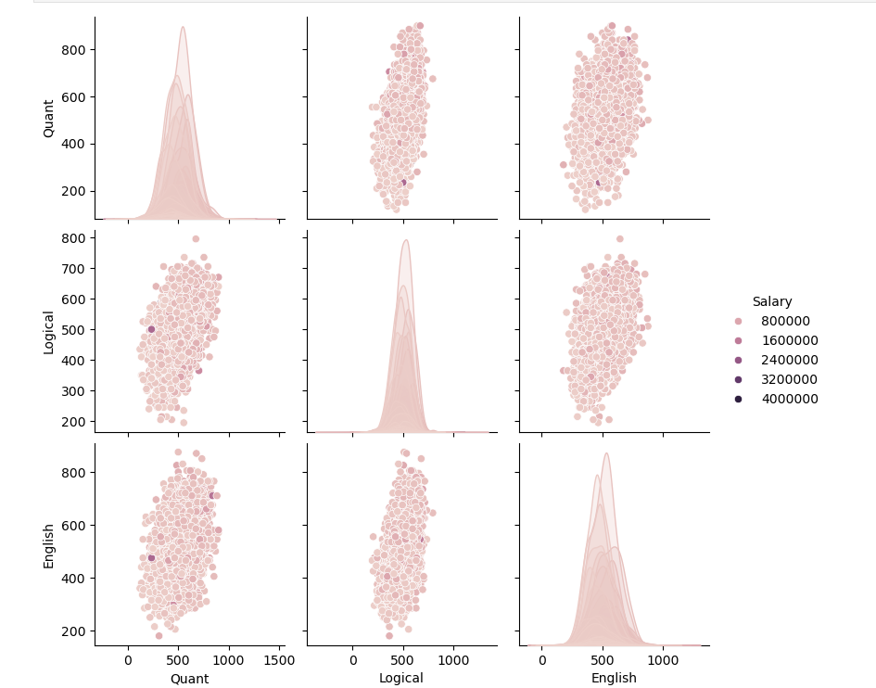
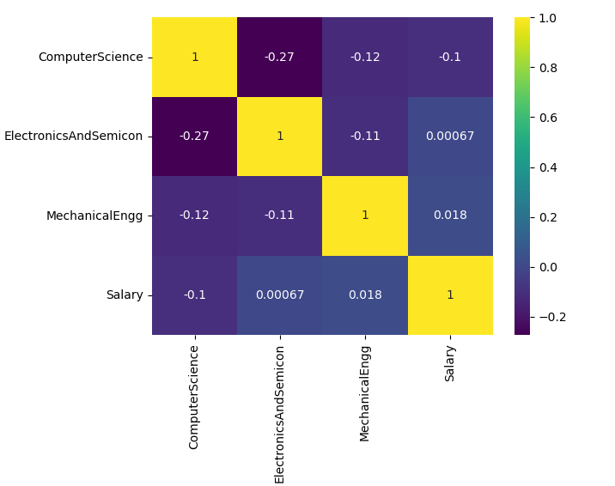
Multivariate Analysis

Slide 8
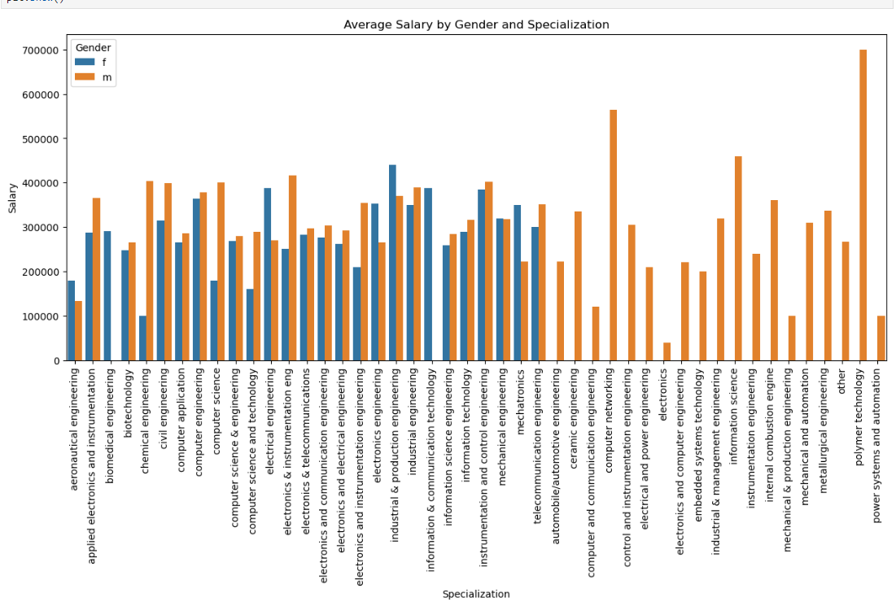
Multivariate Analysis

Slide 9
Observations
Salary Distribution: Average salaries vary significantly across different job roles, with higher pay observed
for technical positions such as Software Engineer and Programming Analyst.
Specialization Impact: Graduates with Computer Science and IT specializations generally
receive higher compensation compared to other fields, indicating a strong demand for tech-related skills.
Gender Disparity: There is an uneven gender distribution, with male candidates outnumbering
females in most technical roles, suggesting a potential gender imbalance.
College Tier Influence: Graduates from Tier 1 colleges tend to have higher starting salaries compared to
Tier 2 and Tier 3 college graduates, showing the impact of institutional reputation.
Skills Correlation: Technical and analytical skills like programming, along with behavioral traits such as
conscientiousness, are positively correlated with higher salaries and job placements.

Slide 10
Conclusion
The AMCAT dataset provides valuable insights into employment trends, salary distributions, and the impact of academic background and skills on career outcomes for fresh graduates. By analyzing this data, companies can identify the most in-demand specializations and skill sets, which can help optimize recruitment strategies. It can also serve as a benchmark for educational institutions to align their curriculum with industry needs. Furthermore, understanding gender representation and salary disparities can aid in developing policies for a more diverse and inclusive workforce in the future

Slide 11

THANK YOU

